Slide 1

Microprocessors and Assembly Language Fall 2019
Hamed Farbeh
farbeh@aut.ac.ir
Department of Computer Engineering
Amirkabir University of Technology
Lecture 20

Slide 2
Copyright Notice
Parts (text & figures) of this lecture are adopted from:
https://www.analogictips.com/pulse-width-modulation-pwm/
Atmel | SMART ARM-based MCU DATASHEET, SAM3X / SAM3A Series, Atmel-11057C-ATARM-SAM3X-SAM3A-Datasheet_23-Mar-15
Microprocessors and Assembly Language, Fall 2019, AUT, Tehran, Iran

Slide 3
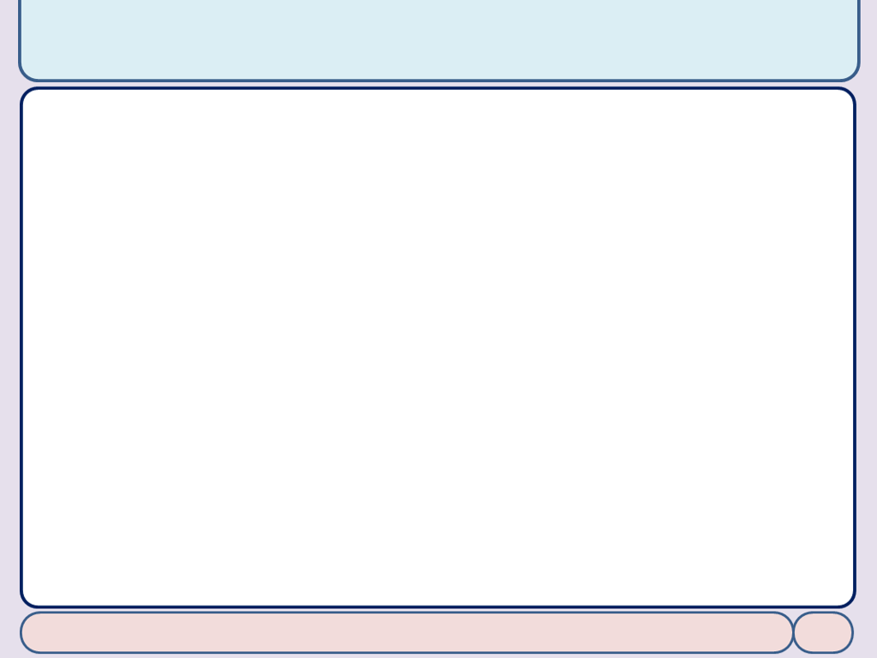
Pulse Width Modulation (PWM)
Microprocessors and Assembly Language, Fall 2019, AUT, Tehran, Iran

Slide 4
PWM: What is it and how does it work?
Digital signals have two positions
on or off, interpreted in shorthand as 1 or 0
Analog signals can be
on, off, half-way, two-thirds the way to on, and an infinite number of positions between 0 and 1
To take an analog input signal (e.g., temperature) into a microcontroller
by using an analog-to-digital converter
But what about outputs?
PWM is a way to control analog devices with a digital output
Drive analog devices like variable-speed motors, dimmable lights, actuators, and speakers
https://www.analogictips.com/pulse-width-modulation-pwm/
Microprocessors and Assembly Language, Fall 2019, AUT, Tehran, Iran

Slide 5
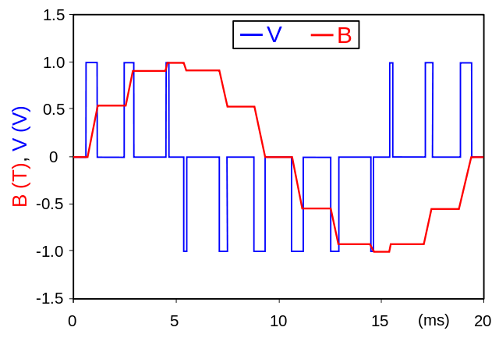
PWM: What is it and how does it work?
PWM is not true analog output
PWM “fakes” an analog-like result by applying power in pulses, or short bursts of regulated voltage
Is a fancy term for describing a type of digital signal
https://www.analogictips.com/pulse-width-modulation-pwm/
Microprocessors and Assembly Language, Fall 2019, AUT, Tehran, Iran

Slide 6
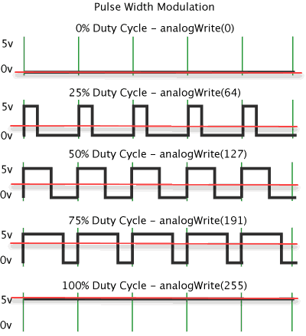
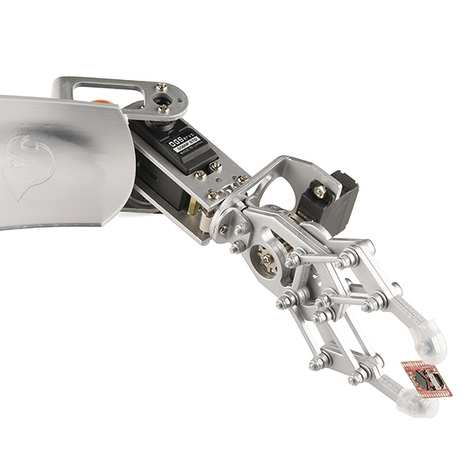
PWM: What is it and how does it work?
A device that is driven by PWM ends up behaving like the average of the pulses
The average voltage level can be a steady voltage or a moving target (dynamic/changing over time)
Average Voltage =
Duty Cycle x High Voltage Level
https://www.analogictips.com/pulse-width-modulation-pwm/
Microprocessors and Assembly Language, Fall 2019, AUT, Tehran, Iran

Slide 7

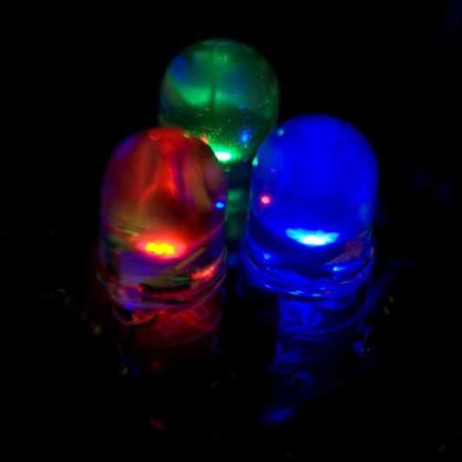
PWM: An Example
Controlling the brightness of an LED by adjusting the duty cycle
With an RGB (red green blue) LED,
you can control how much of each of the three colors you want in the mix of color by dimming them with various amounts
https://www.analogictips.com/pulse-width-modulation-pwm/
Microprocessors and Assembly Language, Fall 2019, AUT, Tehran, Iran

Slide 8
PWM in SAM3X
The PWM macrocell controls 8 channels independently
Each channel controls two complementary square output waveforms
Embedded Characteristics
Common Clock Generator Providing Thirteen Different Clocks
A Modulo n Counter Providing Eleven Clocks
Two Independent Linear Dividers Working on Modulo n Counter Outputs
Independent Clock Selection for Each Channel
Independent Period, Duty-Cycle and Dead-Time for Each Channel
Atmel | SMART ARM-based MCU DATASHEET, SAM3X / SAM3A Series, Atmel-11057C-ATARM-SAM3X-SAM3A-Datasheet_23-Mar-15
Microprocessors and Assembly Language, Fall 2019, AUT, Tehran, Iran

Slide 9
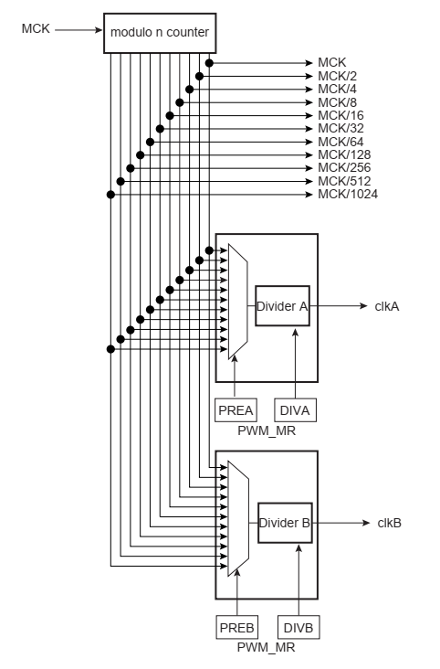
PWM in SAM3X
PWM Clock Generator
Atmel | SMART ARM-based MCU DATASHEET, SAM3X / SAM3A Series, Atmel-11057C-ATARM-SAM3X-SAM3A-Datasheet_23-Mar-15
Microprocessors and Assembly Language, Fall 2019, AUT, Tehran, Iran

Slide 10
The End (for now)!
Microprocessors and Assembly Language, Fall 2019, AUT, Tehran, Iran

